Slide 1



PEGASUS CLIENT PORTAL
USER GUIDE
Version 1.32
Notes:
Contractor

Slide 2
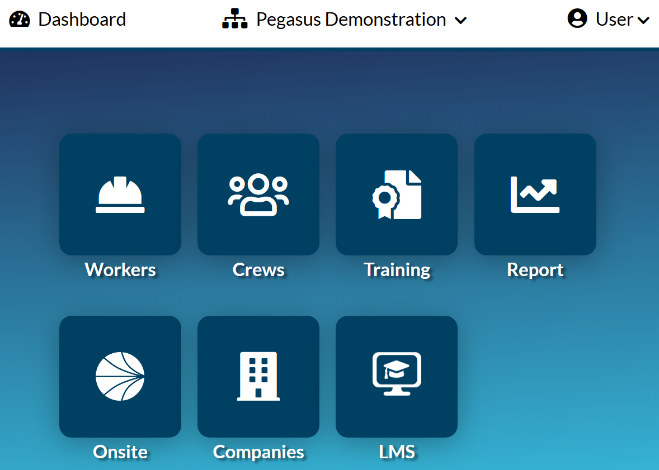
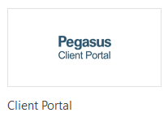
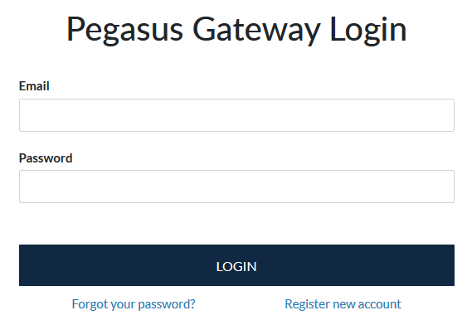

Login to the Client Portal
This guide assumes you already have an existing Pegasus Gateway Login and you have a Site or Realm user account in Onsite Track Easy.
It also assumes you have created you Onsite Track Easy Tile in the Pegasus Gateway and then have added the Pegasus Client Portal Tile.
Aim: To allow Client Portal Users (Onsite Track Easy Administrators/ Super Users/Supervisors/Data Administrators) the ability to perform a number of functions in the Client Portal.
Benefit: The Client Portal offers a more streamlined view and approach to manipulating Employee and Contractor data that’s pulled from Onsite Track Easy.
More information about the Pegasus Client Portal can be found at: https://kb.pegasus.net.au/display/CA/Client+Portal
Go to https://login.poweredbyonsite.com and log in with your Pegasus Gateway Account
Click on the Client Portal Tab
This will log you in to the Client Portal and give you access related to your Onsite Track Easy User Rights and Permissions

Slide 3
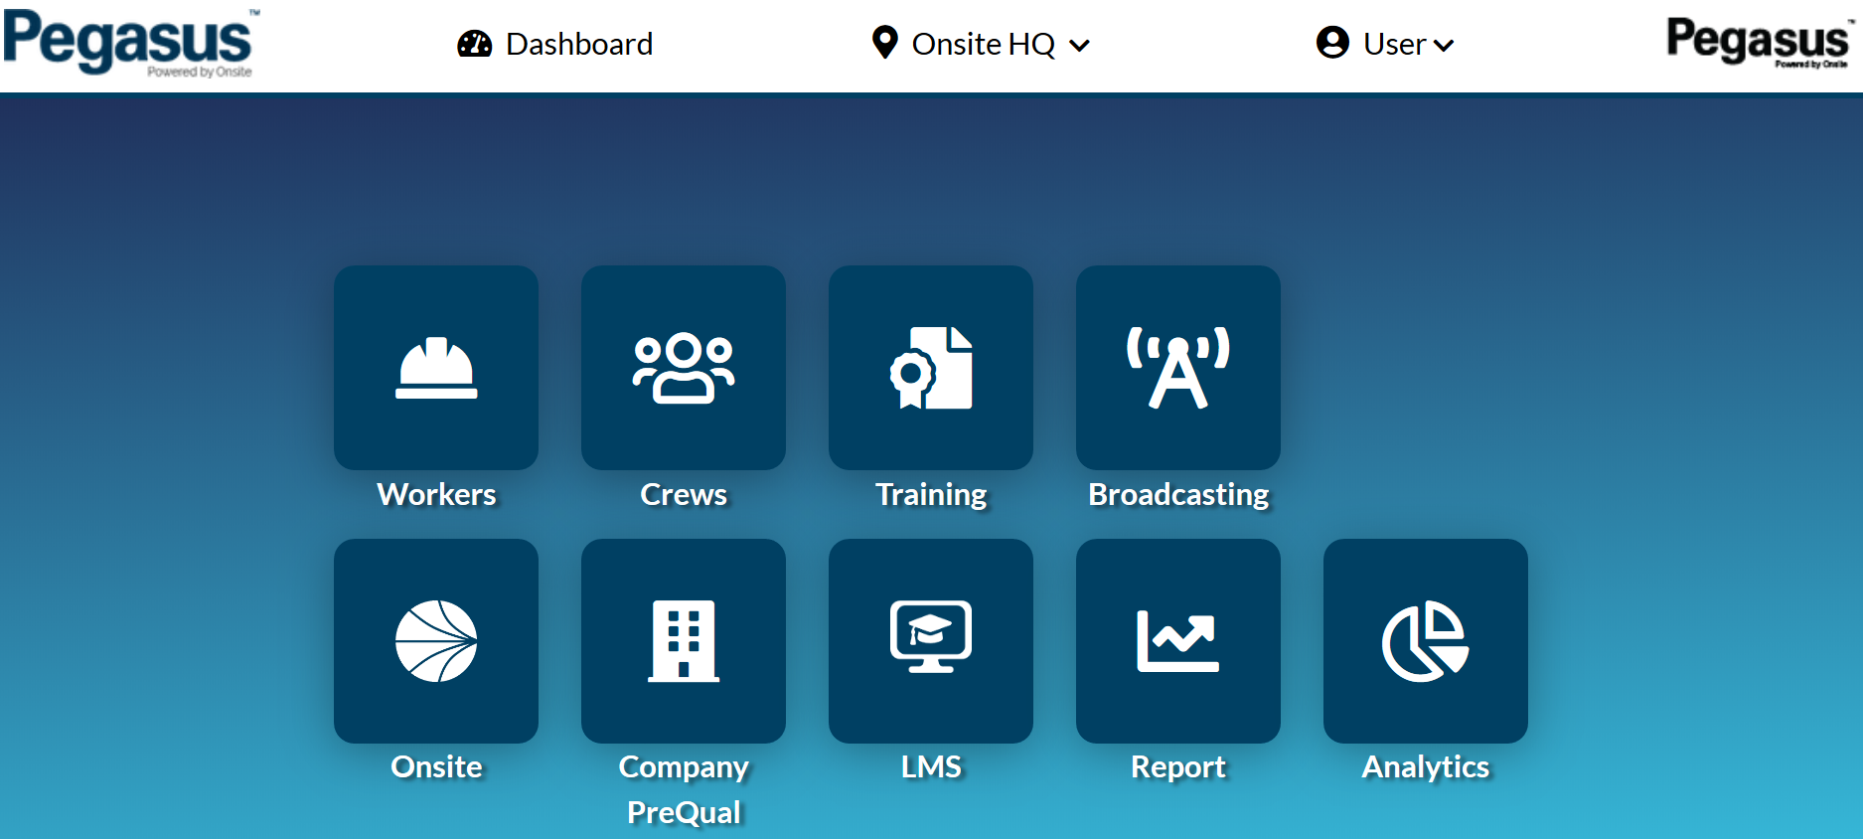
Login to the Client Portal – Notes on your access
The generic Pegasus Demonstration Realm and Site will be used throughout this documentation.
The colour scheme you will see is the approved layout Pegasus has applied to your company.
Some features are restricted depending upon your Onsite Track Easy User rights. You might not have the ability to edit or modify in some cases.
Training, Report, Companies, LMS, Broadcasting and Analytics all require certain User Rights from Onsite Track Easy.
The “User” dropdown arrow will display your currently logged in Onsite Track Easy Account.
Click on “Dashboard” to return to the Pegasus Gateway screen
Click the dropdown arrow on your site/realm to change to another location, if you have those permissions.

Slide 4
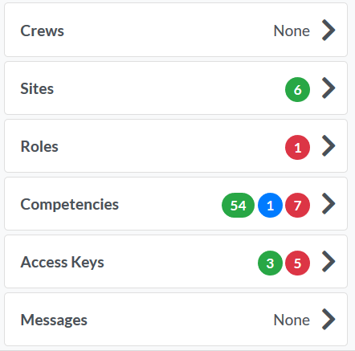




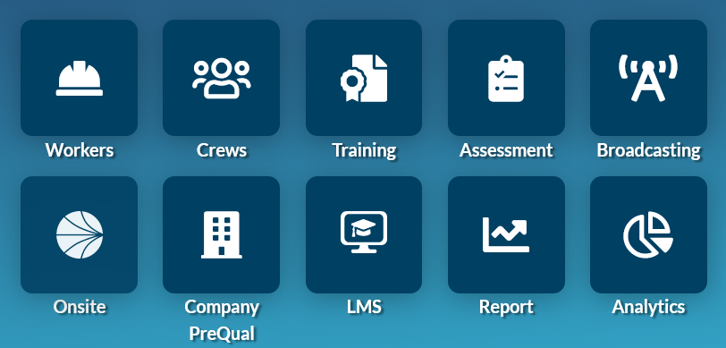

Legend Page – Common Icons and Features
This is the Edit Icon. Visible when you have permissions to edit.
The Colour Status icons represent Status on pages.
GREEN = Active and Valid
AMBER = Expires withing 30 days
BLUE = Pending Status
RED = Expired
Colour Status Icons are visible on multiple pages in the Client Portal, limited to Workers, Crews and Training Pages.
The “
The Add Icon. Visible when you have permissions to add a component
(e.g. Competency)
The Bulk Add Icon. Visible when you have permissions. Used for adding people in bulk. (e.g bulk add people to a crew)
Down Arrow can change Realm/Site if you have access.
User will open your Client Portal Profile and show current version
Cog shows Batch Jobs Module for those with Bulk Add Permissions
Dashboard Returns you to the Pegasus Gateway
The Worker, Crews, Training, Report and Messages Tile Icons will launch the appropriate page in the Client Portal.
The Onsite, Companies and LMS Tiles will open a page in a new browser window. These are separate items to the Client Portal and will open in a new window but use your Onsite Track Easy user rights and permissions.
Assessments , Broadcasting and Analytics are additional tools only available after being enabled by your Pegasus Account Manager.
The filter option appears on various pages. Click on each status icon to filter out unwanted Competencies, Roles, Access keys, to focus on the ones you need.
The Search option allows you to type in letters or words to start filtering out unwanted items. Can be used in conjunction with the Status filter.

Slide 5

TABLE OF CONTENTS
Viewing Worker Profiles 6
Adding an Existing Worker 12
Adding a New Worker 18
Managing Blocks on Workers 25
Managing Access Keys 34
Onsite Now/Log Off/Emergency Evac 39
Assigning Competencies 48
Adding Roles 50
Renewing an Expired Competency 52
Managing Crews 59
Optional Tools 64

Slide 6
VIEWING WORKER PROFILES

Slide 7
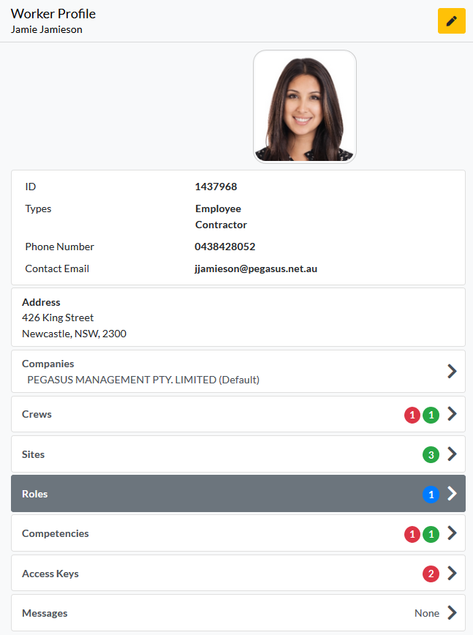
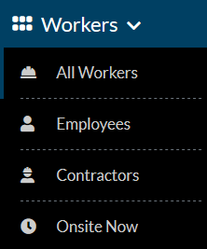
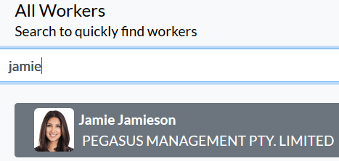
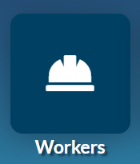

Viewing Worker Profiles
Enter the Worker Module
Select your Worker group from the listed options.
Search for Worker using notes on the right, or scroll with mouse through names defaulted to first name alphabetically.
Click on their name to view their profile
Can search for workers through the All Workers, Employees or Contractor option. Onsite Now can also be used, but will only show currently logged in to site Workers
Searching for workers can be done by:
- First Name and/or Last Name
- Company Name
- ID Number
- Combination of Name and Company Name (e.g Phil Electrical )
Click Edit icon in top right to change worker details, if you have those user permissions.

Slide 8
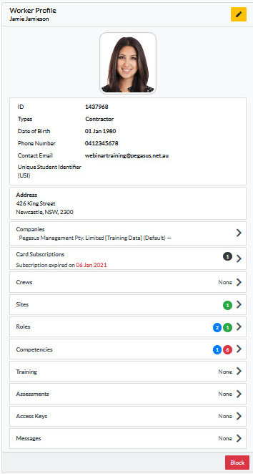
Viewing Worker Profiles
Standard View
Viewing a Workers profile is standard.
Depending upon Workers configuration at your Site/Realm, different status will show against each item.
Can Edit Worker Personal Data and Block worker from this screen, if your account has relevant permissions.
USI – Can be added/modified
Card Subscriptions – shows current status for the worker only.
Every user has access to view worker profiles. Those with user right “Can access Private Data“ will see extra information.
Not all worker “sections” will have a status, it will depend upon what is enabled at site. Some sites are not using Assessments or Messages.

Slide 9
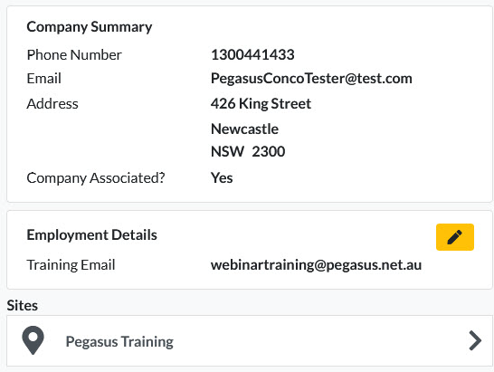
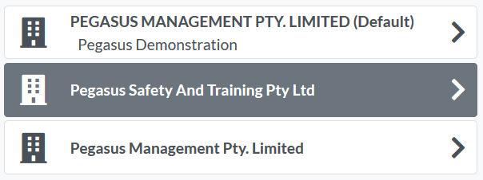
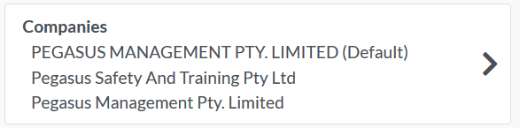
Viewing Worker Profiles – Companies Section
Click on their Companies section under their profile
Click on the company you wish to view
Contact details for that company will be listed
Workers can be employed by multiple companies
One company is designated as the default, which is the one listed against when the sign into a logpoint/turnstile at sites.
Changing the default company is currently still completed in Onsite Track Easy under the workers profile page.
Workers training email address is listed. Can be edited if required. Should be workers personal email in order for all training content to successfully be sent to worker when enrolled.

Slide 10
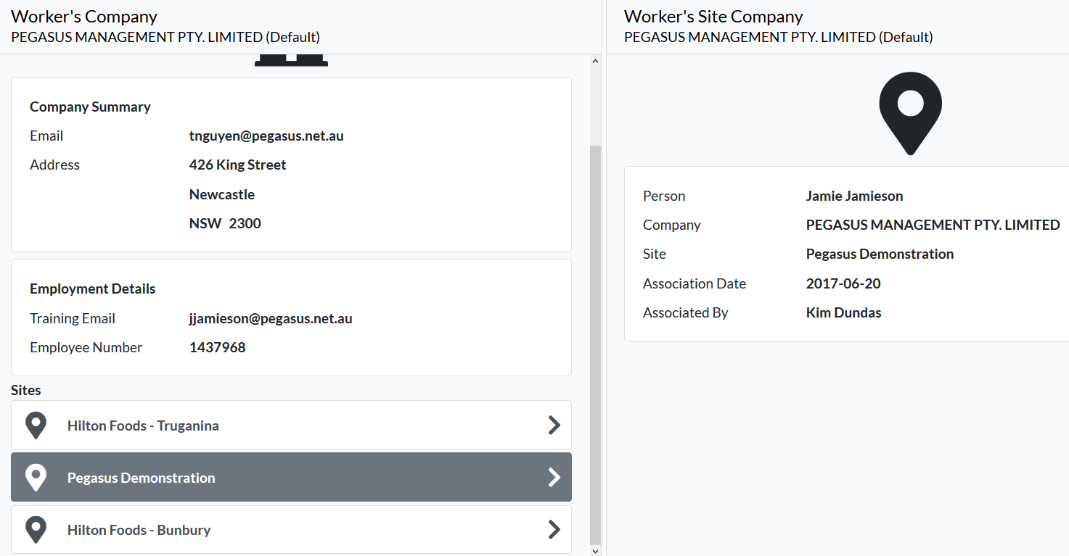
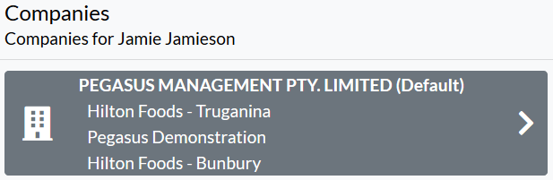
Viewing Worker Profiles – Companies Section
To view the sites this Worker is associated against that company:
Click on the Company
Scroll to bottom of page to list associated sites
Click on relevant site to see date associated
Workers can be employed by multiple companies
One company is designated as the default, which is the one listed against when the sign into a logpoint/turnstile at sites.

Slide 11
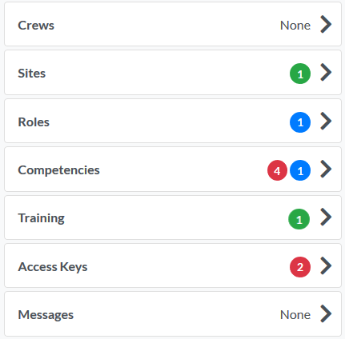
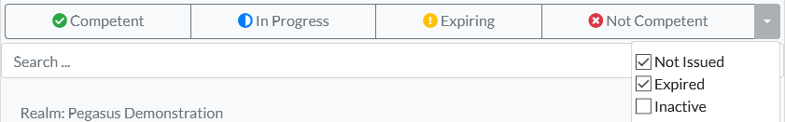
Viewing Worker Profiles – Crews, Sites, Roles, Competencies, Training, Access Keys and Messages
To view items of a workers profile, click on each Tab to expand it to the right to view more.
All Tabs view the same
According to Traffic Light Status system, status colours will apply so you can see what need immediate attention.
All levels of user access will be able to see status. So even those with just Viewer Access in the system.
Most Tabs will open to screen where you can search for a named item or filter out the results using the header colour icons.
Access to manipulate data in each Tab section relates once again to your user access permissions in Onsite Track Easy.
Competencies can be filtered through drop down box, to filter additional views as seen in screenshot below.

Slide 12
ADDING AN EXISTING WORKER

Slide 13
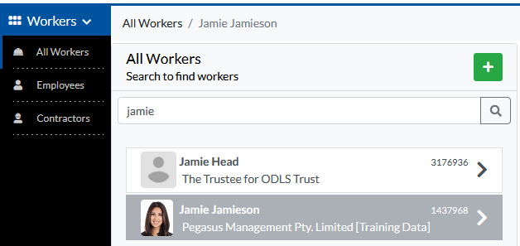
Adding a Worker
Adding a worker feature allows new employees to be added to Onsite under a company.
Does require Permission
Part of adding the new worker is checking to see that a duplicate does not already exist in the system.
If a duplicate already exists, you can opt to select that found worker instead of creating a new possible duplicate.
Must have permissions: “Access = Data Editor” and
“Can Access Private Data = Enabled” in order to add new workers
Follows similar workflow that still exists in Onsite Track Easy, but moving this into a feature of the Client Portal for Admins.
NOTE: Card subscriptions can not be added here but must be added and paid for through the relevant Worker Portal. See this page for more information https://kb.pegasus.net.au/display/CA/Worker+Portal

Slide 14
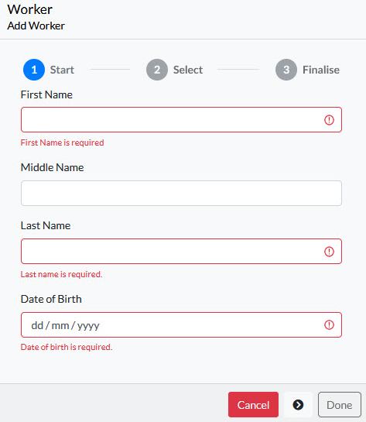

Adding a Worker – Select Existing Worker
Start adding a worker with the + icon
Input First Name
Input Last Name
Input Date of Birth
Press the Next Arrow
when ready to proceed.
Users will be able to search globally for existing workers, by inputting key information.

Slide 15
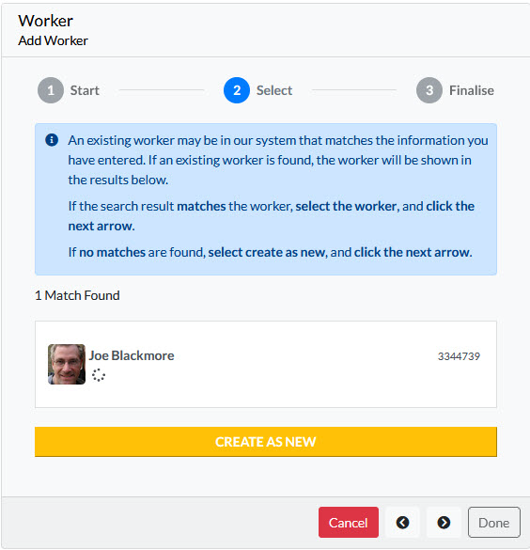
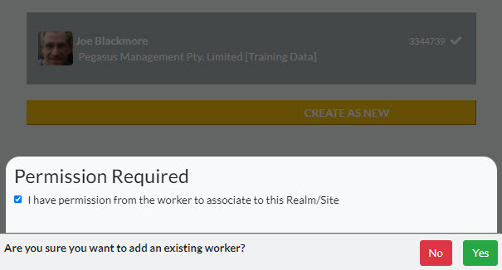

Adding a Worker – Select Existing Worker
Users will have the option to select an existing profile, if one is found, or create a new profile
Demo here show Joe already exists and you can see why company he works for. Permission is required to associate this existing worker.
This is a prompt to ensure correct processes are being followed.
View below shows if existing worker is found matching details.

Slide 16
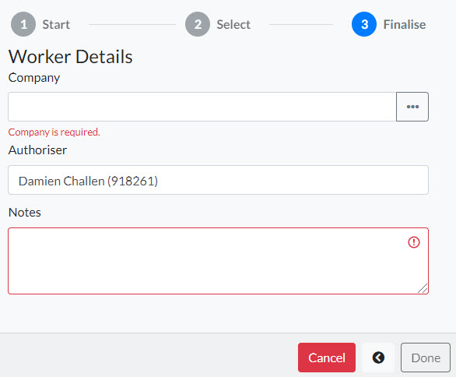
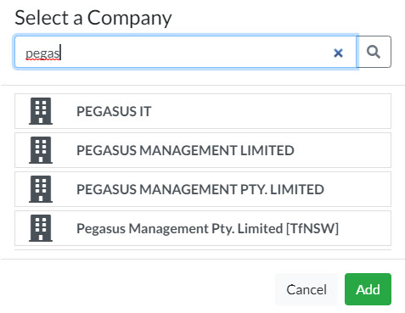
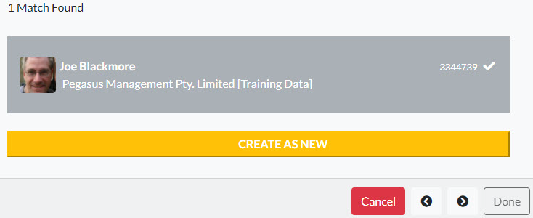
Adding a Worker – Select Existing Worker
Selecting Joe as the existing worker
Press Next
Will now be presented with what company they work for.
If company is NOT associated to site/realm, then will be given option to select company they work for.
Once company found, click Add to have that worker associated as an employee for that company.
Managing workers through this process should be taken with caution, to ensure the correct company is being associated to that worker. If unsure Check with the workers company first.

Slide 17
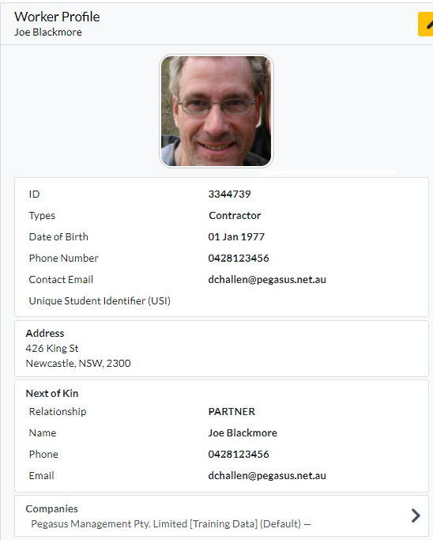
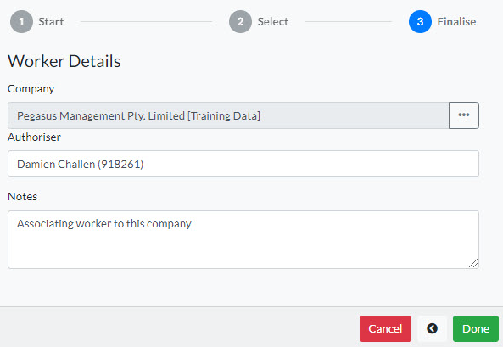
Adding a Worker – Select Existing Worker
After Added, enter in required notes for the worker being added.
Press DONE when ready.
Worker page will refresh and show this worker now associated to site and what company they are working for.
Once completed, this worker will be in the system officially as working for this company.

Slide 18
ADDING A NEW WORKER

Slide 19
Adding a Worker – New Worker
Adding a worker feature allows new employees to be added to Onsite under a company.
Does require Permission
Part of adding the new worker is checking to see that a duplicate does not already exist in the system.
Must have permissions: “Access = Data Editor” and
“Can Access Private Data = Enabled” in order to add new workers
Follows similar workflow that still exists in Onsite Track Easy, but moving this into a feature of the Client Portal for Admins.

Slide 20
Adding a Worker – New Worker
Start adding a worker with the + icon
Input First Name
Input Last Name
Input Date of Birth
Press the Next Arrow
when ready to proceed.
NOTE: Done does not become greyed out until the end of the process is reached.
Users will be able to search globally for existing workers, by inputting key information.

Slide 21

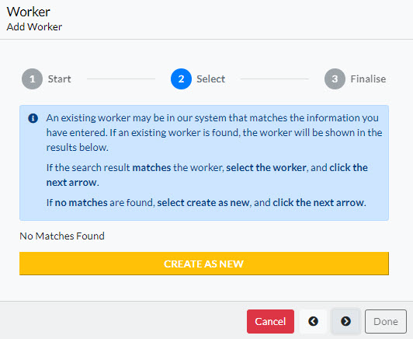
Adding a Worker – New Worker
If no match is found, Press CREATE AS NEW
This will show a tick, then press the Next arrow once more to progress
View below shows if no existing worker is found matching details.

Slide 22

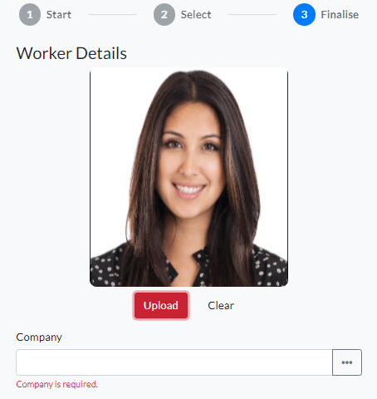

Adding a Worker – New Worker
Add a new phot by uploading the relevant image file
A picture editor module will allow you to crop, rotate, re-align or flip the photo for best view.
Press Apply to
commit this photo.
Photo can be changed
again if required before
continuing.
Move onto completing
Workers Details
Picture format is limited to JPG picture files only .
Ensure photo is Passport Style Format. It should be on clear background, no sunglasses, no hats, and not blurry.

Slide 23
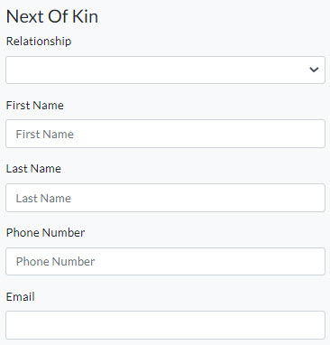
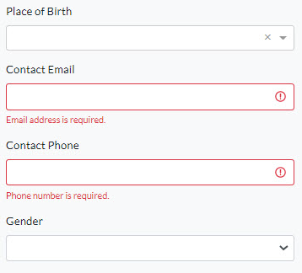
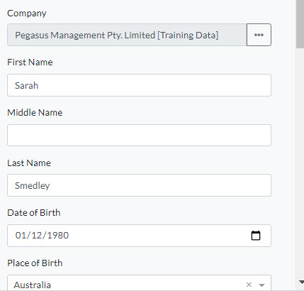

Adding a Worker – New Worker
Complete all highlighted details for the Worker. These will vary between clients.
Red bordered items are mandatory items
Once all complete press Done
Validation will occur on some fields, or drop down lists to choose from locations ( country/state )

Slide 24
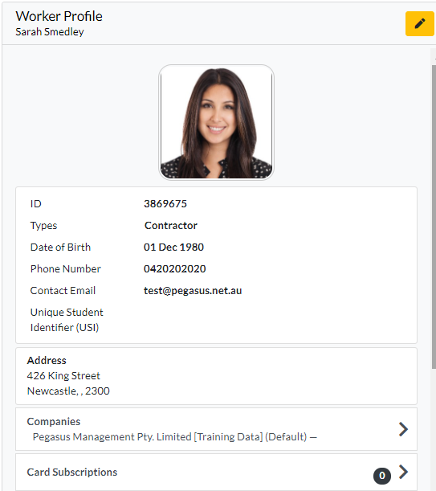
Adding a Worker – New Worker
New Unique Pegasus Worker ID now shows against their Profile
Note: For clients who enforce a Unique Email Address, the worker’s email address must be exclusive for the worker’s profile to be saved.
The user will be advised if the worker’s email address is not unique.
ID CHECKS:
A worker who has an existing ID Check recorded against their profile will have the following fields locked during the Edit Worker function:
Photo
First Name
Middle Name
Last Name
Date of Birth
Can now edit this worker and modify any other items if required/needed to change.
NOTE: Card subscriptions can not be added here but must be added and paid for through the relevant Worker Portal. See this page for more information https://kb.pegasus.net.au/display/CA/Worker+Portal

Slide 25
MANAGING BLOCKS ON WORKERS

Slide 26
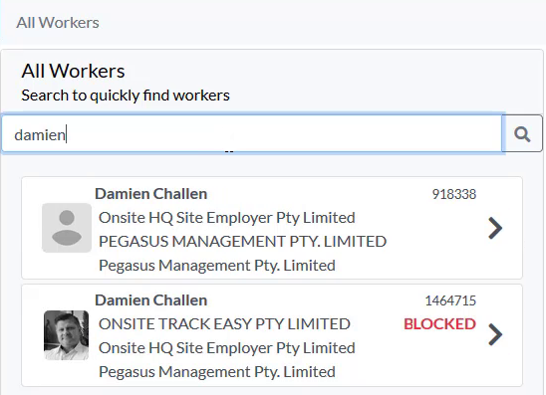
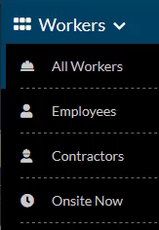
Viewing Blocked Worker Profile
In the Workers Module, Search for your Worker or scroll to view all Workers alphabetically by first name
Workers with a Site/Realm block with have the “BLOCKED” text next to their profile.
Click on the Worker
A Blocked Worker will be denied access to log into sites at a Logpoints. An alert will be sent to listed contacts if Blocked Worker attempts site access at a logpoint.
All users of the Client Portal can see any Blocks a Worker has.
Blocks are also reflected in the Mobile App.

Slide 27
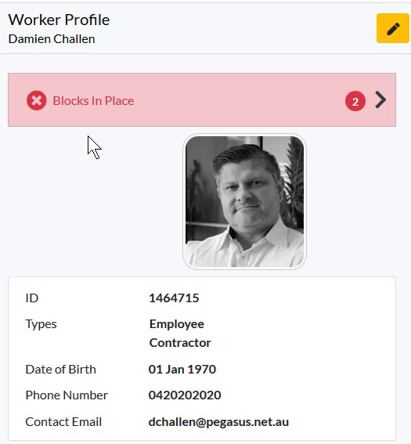
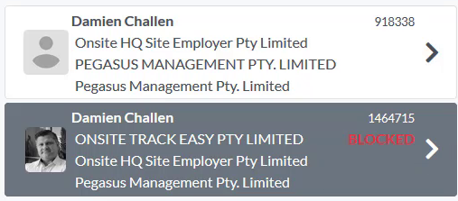
Viewing Blocked Worker Profile
Number of applied blocks will show against the Workers Profile Page
Click on the Red shaded “Blocks in Place“ section to see the details
Blocks do not stop the ability to view a Workers Profile.

Slide 28
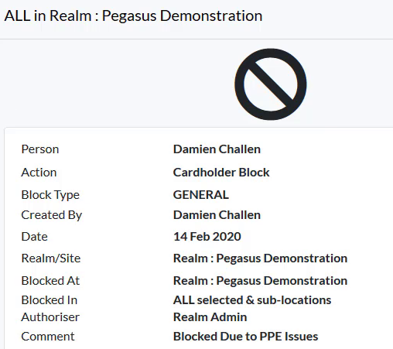
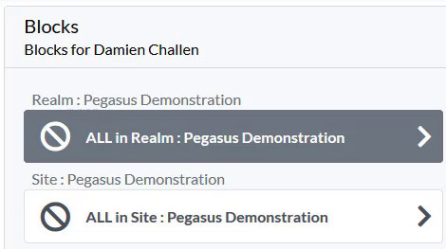
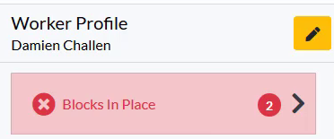
Viewing Blocked Worker Profile
Listed Blocks will show at the Realm level, and then Site Blocks listed under there.
Click on the Block you wish to read more about.
Comment section may not be visible if it was deemed a “Restrictive Comment” when created.
All other data is visible to all users of the Client Portal.
Workers can be Blocked at the Realm, Site or at a particular Location.
Site Alerts can be configured to alert specific email addresses if a Blocked Worker is attempting to log into an Access Point (Boomgate/Turnstile/Logpoint/Kiosk/Tablet) where they are Blocked.
Restricted Comments can be added so only those with user right “Can Access Private Data” will be able to read.

Slide 29
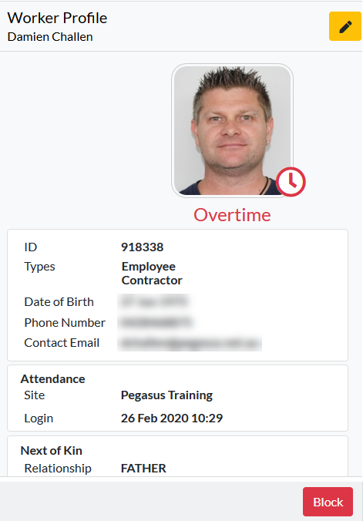

Blocking a Worker
Click on the Worker profile you wish to Block
Click the “Block” button at the bottom right of the profile
A new screen will appear asking for the reason for the block
Only users with the right “Can Block Cardholders” are able to use this feature.

Slide 30
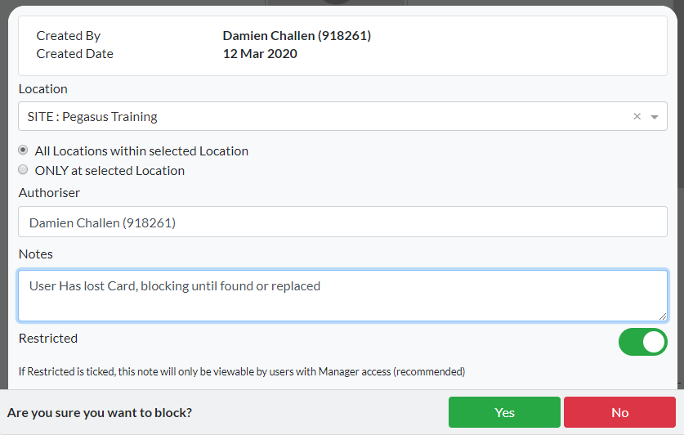
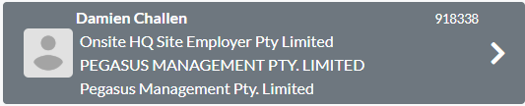
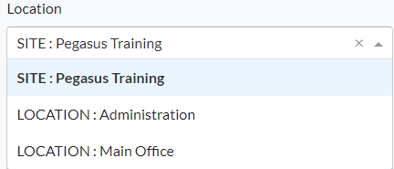
Blocking a Worker
Click on the Dropdown Arrow and select the Location, if applicable, where the Block will occur.
If no location chosen, default will be “All Locations within selected Location” at the Site/Realm.
Authoriser Details logged against the block.
Enter in the Note for the Block.
Choose if note is restricted to certain viewers.
Press Yes when ready.
Restricted Comments can be added so only those with user right “Can Access Private Data” will be able to read.
Workers can be Blocked at the Realm, Site or at a particular Location.
A Note must be given. It is recorded then as an Admin note in the Onsite Track Easy system.

Slide 31
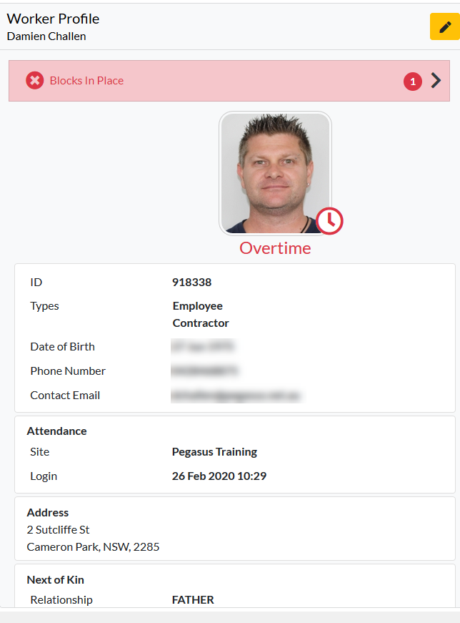
Blocking a Worker
Worker is now Blocked.
View the worker profile and you will see the block listed against their profile
Click on the “Block in place” to review as mentioned in previous slides.
Blocks are only relevant to your Site/Realm. Cannot see blocks from other Clients.

Slide 32
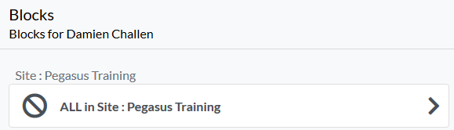

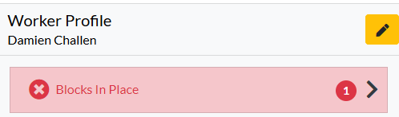
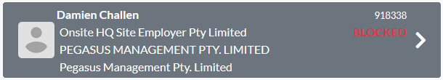
Unblocking a Worker
Worker is now Blocked.
View the worker profile and you will see the block listed against their profile
Click on the “Block in place” to review
Click on the Block location to review (if multiple exist)
Blocks are only relevant to your Site/Realm. Cannot see blocks from other Clients.
Realm level blocks will also show against a worker at all sites under that Realm
Site blocks will only show when looking at the relevant site in the Client Portal. (unless looking at the Realm Level view)

Slide 33
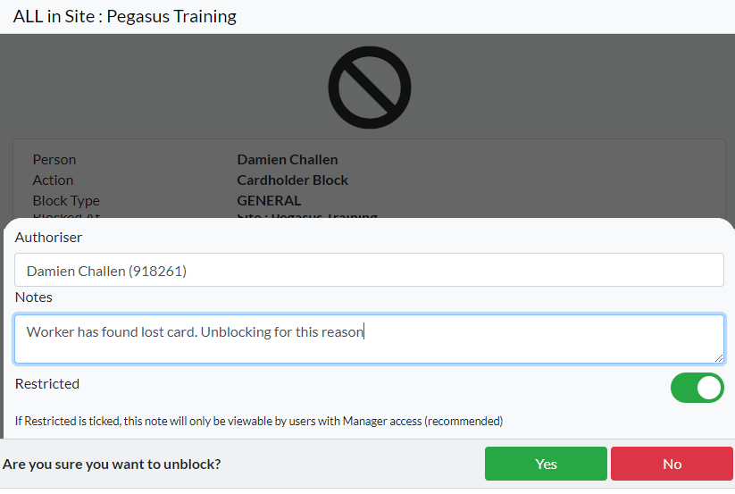
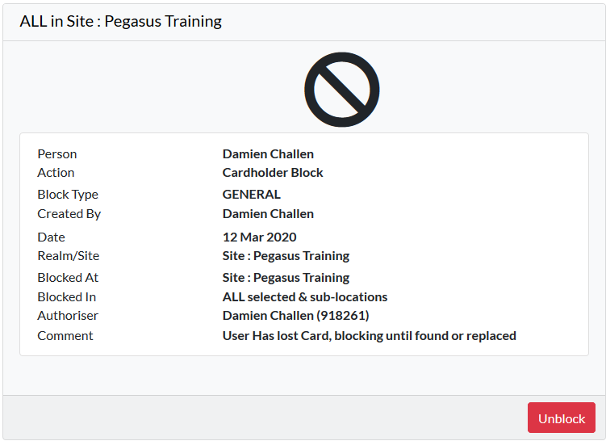
Unblocking a Worker
Click the Unblock button
Supply a reason for the unblocking or editing of the block.
Authoriser Details logged against the block.
Clock Yes when ready to Unblock
Cardholder will now be unblocked.
Blocks can be edited to make note unrestricted if necessary. Must be done by user with those permissions.
Unblock note is stored in Onsite Track Easy system as an Admin Note.
Unblocking will remove flag from cardholder profile and also remove from showing blocked in the Mobile App.

Slide 34
MANAGING ACCESS KEYS

Slide 35


Viewing Worker Access Keys
Enter the Worker Module
Search for Worker or scroll down through the names (defaulted to first name alphabetically).
Click on their name to view their profile
View their Existing Access Keys
Access Key is a control that determines access to a location or site.
An Access Key depends on competencies, so even when someone has the Access Key assigned to them, it will only work if they have all the required current competencies assigned.
When the Access Key does not have any required competencies, simply assigning the key to a person provides them with site access.

Slide 36




Viewing Worker Access Keys - Adding
Click on the Access Key Tile
Click the Plus Sign to Add an Access Key
Choose the Access Keys to Add
All Keys can be added, but status indicator of Access Key will show Red if Worker does not meet requirements
NOTE: Some keys might be added automatically by site configuration settings.
Can add multiple Access Keys at the same time
Thumbs Up Indicator – Worker Meets those requirements already
No Thumb indicator – Worker DOES NOT meet requirements.

Slide 37




Viewing Worker Access Keys - Adding
View Access Key Requirements by Clicking on Key
Clicking on Competencies
See breakdown of Access Key Components.
Use Colour coding to instantly see which Competencies are Valid (Green) Expiring in 90 days or less (Amber) or Expired/Not Issues (Red)

Slide 38


Viewing Worker Access Keys - Removing
View the access key you wish to remove
Click on Remove Button
Prompt will appear to confirm action
Press yes to confirm
Access Key will be removed
NOTE: Keys can be reassigned by a site admin or the system in some circumstances.
Removing Keys done not remove worker Competencies or Roles

Slide 39
ONSITE NOW, LOG OFF WORKER & EMERGENCY EVACUATION

Slide 40



Viewing Worker Profiles – Onsite Now
To view current Logged in Workers, click “Onsite Now”
Lists all workers logged in at site. Employees, Contractors and Visitors
Shows fatigue status indicator
Shows Attendance field - details logpoint information and time of login.
Can click on Worker profile in Onsite Now to view that Workers Profile in Full
If navigating workers onsite of Onsite Now, will also display Icon showing if they are currently logged in.

Slide 41

Viewing Worker Profiles – Onsite Now
A filter is available above the list of Workers Onsite Now.
Can use filter to show only those logged in - Under 12 Hour Fatigue Limit (Green)
Those in Warning State From 12 hours to 13hrs 59 Minutes (Amber)
Or Overstayers - Over 14 Hours (Red)
If viewing an Onsite Now worker on another screen, it shows the same Status and Attendance fields while they are still logged in.
Green = Under Site Fatigue Limit
Amber = Approaching withing 2 hours of Site Fatigue Limit
Red = Over Site Fatigue Limit
Typical Site Fatigue limit is set at 14 hours.
Icon visible in other Worker screens while navigating Client Portal
Number of workers in each fatigue level also shown in brackets

Slide 42



Viewing Worker Profiles – Log Off Worker
When viewing a worker profile, the “Log Out” option is visible if the worker is currently logged in at site
“Log Out” also appears in Onsite Now page when viewing a worker
To action a worker, Click on “Log Out”
Enter in any mandatory field items
Click Yes when asked are you sure.
Worker is the logged out of site.
Only appears if have the user right “ can Log persons in and out”
Will need to give reason before able to apply the logout
Will record the person making the logout in admin notes for later review.
Once logged out, worker will no longer appear in onsite now reports until they log back in.

Slide 43

Viewing Worker Profiles – Emergency Evacuation
To view printable list of Workers currently at site, click Emergency Event
Can filter by Person
Can Print Results
Click “Company Icon” to return to Console in Client Portal
Feature does NOT work at the Realm. Must be at a site level to view Onsite Now and Emergency Evacuation modules
If active, Activities and Crew fields will show those details of cardholders
Default view is to list my Logpoint and then from earliest to oldest logins

Slide 44
ASSIGNING COMPETENCIES

Slide 45

Assigning Competencies to a Worker
Enter the Worker Module
Search for your worker
Click on their name to view their profile
Scroll down and click on the Competencies Tab
Note: This step assumes you have permission to add competencies and these actions are being performed at the Site level.
Can search for workers through the All Workers, Employees or Contractor option. Onsite Now can also be used, but will only show currently logged in to site Workers
Searching for workers can be done by:
- First Name and/or Last Name
- Company Name
- ID Number
- Combination of Name and Company Name (e.g Phil Electrical )

Slide 46


Assigning Competencies to a Worker
Click on the “PLUS” icon to add a competency
This will open the Assign Competency page
After a slight delay, it will then bring up the list of Site Competencies
If it doesn’t, you can click on the ellipsis “…” to open the list of all competencies that can be applied to your desired worker.

Slide 47

Assigning Competencies to a Worker
Click on the required Competency you wish to add to the Workers profile
It will then be highlighted, now click “Add”
This will then open the Assign Competency screen again
It will now request more information from you regarding this Competency., before it can be applied.

Slide 48


Assigning Competencies to a Worker
Competency Name will be listed next to (…)
Complete any required items on this screen. Depending upon Competency requirements, some mandatory information might be required
E.g. Issue Date, Expiry Dates or
Description Information
If required, Location of
Competency might also need
to be chosen.
Click “Save” when completed.
Locations will change depending upon your account and rights.
- Icon denotes a REALM location
- Icon denotes a SITE Location
Important that you apply at the correct level. Talk to a Pegasus representative if you are unsure!

Slide 49

Assigning Competencies to a Worker
Once saved, Competency now stored against worker profile
Option to re-edit if mistakes made can be done by clicking “Edit” icon
Option to add document evidence against Competency can be done by clicking “+ Add Document” icon
Option to “Deactivate” this competency can be done if required.
Depending upon the Competency, some additional steps might be required such as Permit to Train, Train, Assess, Authorise or Appoint. Each will need to be signed off before Competency is Complete.
Competency will sit as “In Progress” until all progress steps performed.
For more information on Pending Steps, please see this video

Slide 50



Assigning Competencies to a Worker – Changing Progress
View Progress Section
Click on Incomplete Action required
Compete the action screens prompted, entering in notes where required.
Step will change from “In Progress” to a successful green text for the completed step.
Additional steps might be required to change progress of a competency from “In Progress” to “Competent”
Each step completed will have information added as to who completed that step. In example below, Damien Challen is recording that Betty White did the training, but his name is recorded against this competency process step.
Green “Trained” text indicates Progress step successfully completed

Slide 51



Assigning Competencies to a Worker – Completed Steps
Once all progress steps completed, competency will show in green text as Competent
Will be visible against Worker profile as Green icon showing valid competency.
“Renew” will restart the process for this competency against this worker. However competency will continue to remain valid until its expiry date.
Competency will also show in Onsite Track Easy against that workers profile, with data and notes matching what was entered while approving this competency.
Document attachments, if any, can now also be viewed by approved editors and viewers.
User Permissions to View Documents are “Can Download Files”

Slide 52




Assigning Competencies to a Worker – Adding a Document
Click “+Add Document”
Click “Browse”
Click “Open” to attach document to competency
Now stored against Competency
Users with rights can now click on Cloud Icon to download and view Document
Document uploads limited to pdf, doc, docx, xls, xlsx, txt, jpg or jpeg file types
Executable or zip/compressed files can not be attached.
User Permissions to Add Documents are” Can Upload Files”.
User Permissions to View Documents are “Can Download Files”

Slide 53
ADDING ROLES

Slide 54
Assigning Roles to a Worker
Roles should NOT be assigned in the Client Portal.
Appling Roles here will not assign online training events, which will make the role unable to be completed for the worker.
Always apply for Roles in the Roles Portal (also called worker portal)
This ensures the correct training is assigned to worker and they are emailed any training enrolments.
You can however use this page to view the status of roles against a workers profile.
If unsure of Roles Portal website, check the client page on
https://www.Pegasus.net.au/contractors for a link on the relevant client page.
More information on roles portal here https://kb.pegasus.net.au/display/CA/Roles+Portal

Slide 55
RENEWING AN EXPIRED COMPETENCY

Slide 56


Expired/Expiring Competency – Renewing
Same process as viewing a Worker’s competencies
Click on Competency under Worker Profile
Click on “Renew”
Enter in associated details and click “Save”
Competency requirements are different for clients and the particular competency.
Some might have additional steps, as listed in this guide, that are required before competency is “Complete”

Slide 57
MANAGING CREWS

Slide 58


Managing Crews - Viewing
Click the “Crews” module icon
Current Complete, Incomplete, and Inactive Crews are listed
Click on a relevant Crew to view its Members
Active Crew = In Use
Inactive Crew = Disabled/not for reporting
Incomplete Crew = Has not met crew minimum members
Note: This step assumes you have user rights permission “ Can Manage Crews” .
Crews can be managed from a Site or Realm level in the Client Portal
Workers can be members of multiple crews at a site
Crews are incorporated into reports such as Onsite Now by Crew, Expiring Competencies by Crew. These focus just on the team members you wish to manage.

Slide 59


Managing Crews - Viewing
Click on the Crew you wish to view
Will show Crew Details.
Ability to Edit Crew Name or Make Inactive is a user permission.
Can still view Crews otherwise.
Click “Members” to continue
Inactive crews can still be managed and viewed, but will not appear on reports unless made active
Can use to build up crews for particular events (e.g. shutdown) and then make inactive once event is no longer operational
Can use crews to create specific groups that other users of the portal can reference. E.g. Fire Wardens, First Aid Officers, Payroll, Receptionists etc.

Slide 60


Managing Crews - Viewing
Can search/filter workers out by Name or Company
Click on Crew Member to view more details
Click on a different Crew member to view their details
Pressing Red Box Icon will change from Crew Module back to Worker Module.
Make Leader is an optional item

Slide 61


Managing Crews - Viewing
Clicking “Make Leader” will place Crown icon next to Worker in crew list and flag under their profile.
Can be removed under worker profile if no longer Leader
Can make Multiple People Crew Leaders, and all will have crown icon .
Worker can also be removed from this screen.

Slide 62



Managing Crews – Adding Members
Clicking “Add” icon allows adding multiple workers at once to Crew.
Can search as before and filter by name, company to get desires workers
Click on each worker you wish to add at once and apply with “Add”
Added people are instantly visible in crew.
Icon to add people to crew is not visible if user rights do not allow.

Slide 63



Managing Crews – Creating New
Under Active or Inactive Crew screen, click “+” to create a new crew
Enter Name for Crew, determine minimum members if needed (optional)
Click Active or Inactive status
Click “Save” to create this Crew
Crews can be Inactive and members still added to them.
No limit on Minimum Members
No Limit on number of crews created

Slide 64
OPTIONAL TOOLS

Slide 65





Optional Tools – Batch Job Module
When choosing to add a Crew
or person type to a Training or
Assessment event, you click the Bulk Add Icon.
Once chosen, the “Select All” option will appear.
Clicking this will select
all workers from the group
and then you can “Add”
them all in one go.
A new screen will prompt.
If you have relevant Manage Classroom/Online Onsite Track Easy permissions, you will see the Batch Cog Icon on the top toolbar.
The Batch Job Module is hidden from view until the icon is clicked.

Slide 66




Optional Tools – Batch Job Module
Prompts before confirming will happen whenever a batch event occurs showing possible outcome.
Once batch started, you can view progress. You can not make changes
Batch status will change over time and progress bar will be visible.
If when bulk adding, people are already in the event they will be added to, it won’t add them a second time.
No email notifications are sent out. The Batch progress is where you will see the outcome.
Once complete, the relevant actions will take place (emails to attendees for example).

Slide 67



Optional Tools – Batch Job Module
You can select option to choose your view of any batches listed
You can not interact or modify.
But you can view status.
Batches have three status
Awaiting = Batch is yet to start processing. Visible if someone started a batch, or a large job has been just chosen to run. If you view these section after you just actioned a large batch, you will see this then.
Processing = Batch is currently being processed
Processed = Batch is finished and you can see status of outcome.
For failed items in a batch, can re-run the same process against those individuals, to try again for success.

Slide 68


Optional Tools – Report
Report loads Business Intelligence Reports in a New Browser Tab
Access is available to all Client Portal Users
Reports can be run or scheduled as necessary.
Multiple can be sent the same report on a schedule via email.
Additional information on Scheduling and managing reports is listed here:
https://kb.pegasus.net.au/display/CA/Business+Intelligence+Reporting
Video guides and Cheat sheets are accessible on that page

Slide 69


Optional Tools – Onsite
Under Onsite – Will open in new tab an instance of Onsite Track Easy, relevant to your user permissions.
Changes made in Client Portal or if made in Onsite Track Easy, are instantly synced between the two.
Onsite contains features still not implemented in Client Portal.
Logpoint Configuration, Safety Selections, creating new Roles and Competencies; are all items still created presently in Onsite Track Easy and are not implemented in the Client Portal.
If you can not find the tool you need, enter Onsite Track Easy. Changes made will be reflected in the Client Portal. E.g. logging an overstayer out of onsite will reflect in the Onsite Now in Client Portal.

Slide 70


Optional Tools – Companies
Companies icon will load in a new browser window, the Company Compliance Client Access View
Access available to all Client Portal Users, locked to your Company Scope.
Reports from this Scope are available to Admins with login permissions.
Show Complaint and Non-Compliant companies
Able to view status, subscriptions, compliance documentation and expiry dates
More information available at this site which contains User Guides and Videos available:
https://kb.pegasus.net.au/display/CA/Company+Pre-Qualification+Portal

Slide 71
FOR QUESTIONS OR ASSISTANCE, PLEASE CALL
1300 131 194
OR EMAIL support@onsitetrackeasy.com.au

